Slide 1






Cardiovascular Health
Forecasting Heart Disease Risk

Slide 2

Introduction
02
Literature Review
01
Reason / Issues causing Heart Diseases
Existence papers and Classifications
Models and early detection bring essential benefits
Discussion of Approaches / Algorithm to Identify Strengths and Weakness
Data Gathering /Data Refinement
Feature Extraction
03
04
Comprehensive Dataset Overview
Divide Features into X and Y
Refinement and Data Preparation Steps
Machine Learning / Deep learning
Methodology
06
Experimental results
05
Algorithms or Models Used
Visuals of Compared models
Compare each Evaluate Algorithm
Accuracy, confusion matrix of models
Conclusion
Appendices and references
07
08
Importance of the used approach
Suggestion for future
Links and codes used in the project

Slide 3
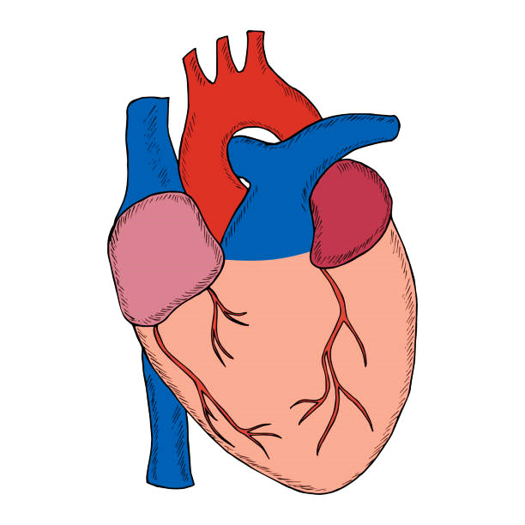


INTRODUCTION
Smoking
Hypertension
Factors Of Cardiovascular Diseases.
Obesity
Sedentary lifestyle
Cardiovascular diseases (CVDs) refers to a group of disorders affecting the heart and blood vessels
Alcohol
Hyperlipidaemia
Common types of CVD include coronary artery disease, stroke, peripheral artery disease, heart failure, and hypertensive heart disease
Early predictions and Data science models in medicine help doctors foresee health issues before they become serious.
`
Identification of potential problems, allows timely interventions and improving patient outcomes.
17.9m
33%
Of All Global death
Fatalities Caused By CVD (each year)

Slide 4



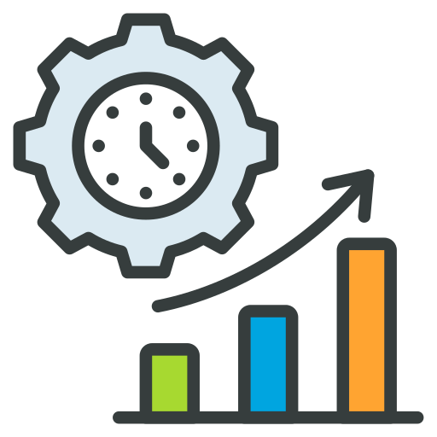


Objective OF The Study
Risk Stratification
Comparing Algorithms
Real - time Monitoring
Value Of The Study
Early detection and Prevention
Improved Patient Outcomes
Public Health Advancement

Slide 5


LITERATURE REVIEW
Insights
Accuracy
87.28%
Multilayer Perceptron
86.5% RandomForestClassifier
87.02%
XGBoost
The primary goal of the study was to classify heart disease using different models and a real-world dataset.

Article Name
The study utilized the Kaggle cardiovascular disease dataset with 70,000 instances, implemented on Google Collab.

Effective Heart Disease Prediction Using Machine Learning Techniques
The researchers applied the k-modes clustering algorithm to a dataset of patients with heart disease, preprocessing the data by adjusting age and blood pressure attributes.

Authors
Limitations of the study include potential lack of consideration of important demographic and clinical variables

Chintan M. Bhatt | Parth Patel |
Tarang Ghetia | Pier Luigi Mazzeo
Future research should involve comparing k-modes clustering with other algorithms, assessing the impact of missing data and outliers on accuracy

Published : 6 February 2023

Slide 6


Monitor and Update
STEP
Continuously monitor the model's performance in the real-world scenario
07
Model Evaluation
STEP
06
Assessing the performance of a machine learning model using metrics
Model Selection and
Model Training
STEP
Choosing a suitable machine learning algorithm and optimizing its parameters
05
Split Train And Test Data
WORK FLOW
WORK FLOW
STEP
04
Dividing the dataset into training and testing sets to evaluate
PREPROCESSING
STEP
Preparing and cleaning data to enhance its quality and suitability
03
Exploratory Data Analysis
STEP
02
Analyzing and visualizing data patterns to understand its characteristics
Data Collection
STEP
Gathering and organizing data to train machine learning models.
01

Slide 7



Data Collection & Refinement
918
12
Heart Failure Prediction
ROWS
UCI
Learning
Machine
Repository
DATASET NAME
COLUMNS
Features
(Columns)
Age
Missing Value
Demographic Information
X
Sex
None
Clinical Data
Chest Pain Type, Cholesterol, FastingBS, RestingECG,
MaxHR, Exercise Angina,
Old peak, ST Slope
Duplicate Values
Heart Disease
0: Normal
Y
Outcome Variable
Outliers
1-Heart Disease
Present

Slide 8







Dividing dataset into “ x ” and “ y ”
Feature Extraction
Standardize the feature data (x)
Dividing dataset into Training Data and Testing Data.
Machine Learning /
Deep Learning
Utilizing Machine Learning for a heart disease prediction classification dataset to harness the power of advanced algorithms and pattern recognition, enabling more accurate and timely identification of potential cardiovascular risks.

Slide 9
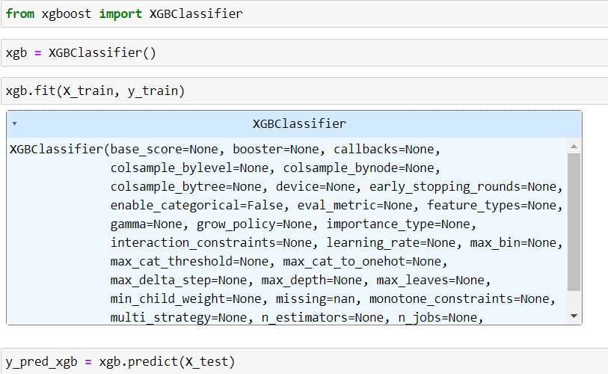
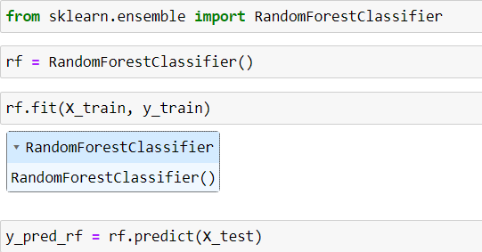
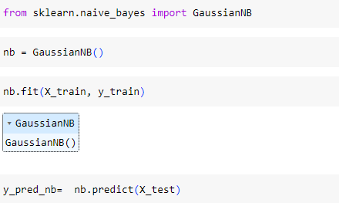
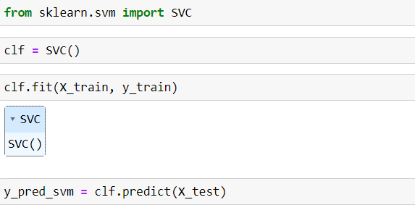
METHODOLOGY
Model
Model
Gradient Boosting Classifier (XGBoost)
RandomForestClassifier
Random Forest:
- Ensemble of decision trees for robust predictions.
XGBoost:
- Gradient boosting algorithm for enhanced accuracy.
Model
Model
Support Vector Machine (SVM)
Gaussian Naive Bayes
Naive Bayes:
- Simple probabilistic model, efficient for quick predictions in medical datasets.
SVM (Support Vector Machine):
- Effective in high-dimensional spaces, ideal for complex datasets.

Slide 10


Accuracy
Precision
Recall
F1-Score
%
%
%
%
Understanding
Random Forest Classifier | 88.40 | 88.24 | 90.91 | 89.55
Support Vector Machine | 91.60 | 91.09 | 92.93 | 92.0
XG Boost | 88.40 | 89.0 | 89.90 | 89.45
KNN Classification | 90.06 | 93.55 | 87.88 | 90.63
Naive Bayes | 86.19 | 87.76 | 86.87 | 87.31
Precision: The accuracy of the model when it claims to have found something.
Recall: Recall: The ability of a model to find all the relevant cases
F1 Score: A balance between recall and precision, useful when both false positives and false negatives need to be minimized.
Experimental Results :
SVM Dominates: Support Vector Machine excels with 91.60% accuracy, balanced precision (91.09%) and recall (92.93%), showcasing superior overall classification performance.
Percentage (%)
Random Forest & XG Boost Consistency: Both algorithms maintain 88.40% accuracy, with Random Forest having higher precision (88.24%) and XG Boost higher recall (89.0%).
KNN Precision, Naive Bayes Balance: KNN achieves 90.06% accuracy and high precision (93.55%) but lower recall (87.88%), while Naive Bayes balances well with 86.19% accuracy and 87.31% F1 Score.

Slide 11




Conclusion
Conclusion
Key Findings
The results indicated that the Support vector Machine model had the highest accuracy of 91.16%
The study utilized the Kaggle Heart Failure Prediction dataset with 918 instances, and all algorithms were implemented on Google Colab
The accuracies of all algorithms were above 86% with the lowest accuracy of 86.19% given by Naïve Bayes and the highest accuracy given Support vector Machine as previously mentioned.
Limitations
Single Dataset Limitation:
The study relies on a single dataset, potentially limiting its generalizability to diverse populations.
Limited Variable Consideration:
The analysis focuses narrowly on demographic and clinical variables, overlooking lifestyle and genetic factors relevant to heart health.
Lack of Test Dataset Evaluation:
The model's performance on new, unseen data is not evaluated, raising concerns about its real-world applicability.
Future research
Future research must ensure robustness, generalizability, and interpretability for informed decision-making based on study findings. It's important to check how missing data and unusual values affect the model's accuracy. Creating strategies to deal with these issues is valuable for improving model performance.

Slide 12


x
References
References

Bhatt, Chintan M., Parth Patel, Tarang Ghetia, and Pier Luigi Mazzeo. 2023. "Effective Heart Disease Prediction Using Machine Learning Techniques" Algorithms 16, no. 2: 88. https://doi.org/10.3390/a16020088

Conflicts of Interest
The authors declare no conflict of interest.

Software Involved
Google Colab
Jupiter Notebook
Microsoft PowerPoint 2021
Microsoft Excel 2021

Slide 13

Thank
Thank
You
You
"Guard your heart, for within its rhythm, echoes the essence of your well-being."

